Slide 1



ML/DL for Everyone with
Lecture 9:
Softmax Classifier
Sung Kim <hunkim+ml@gmail.com> HKUST
Code: https://github.com/hunkim/PyTorchZeroToAll
Slides: http://bit.ly/PyTorchZeroAll

Slide 2

Call for Comments
Please feel free to add comments directly on these slides.
Other slides: http://bit.ly/PyTorchZeroAll
Picture from http://www.tssablog.org/archives/3280

Slide 3
ML/DL for Everyone with
Lecture 9:
Softmax Classifier
Sung Kim <hunkim+ml@gmail.com> HKUST
Code: https://github.com/hunkim/PyTorchZeroToAll
Slides: http://bit.ly/PyTorchZeroAll

Slide 4
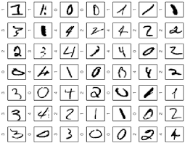
MNIST: 10 labels

Slide 5


10 labels: 10 outputs
Linear
Activation
Linear
…

Slide 6
10 labels: 10 outputs
Linear
Activation
Linear
P(y=0)
P(y=1)
…
…
P(y=9)
Notes:
y \in R^{N\times10}

Slide 7
10 outputs
Linear
Activation
Linear
?
P(y=0)
P(y=1)
…
…
P(y=9)
Notes:
y \in R^{N\times10}

Slide 8
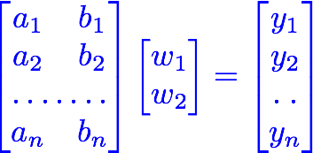
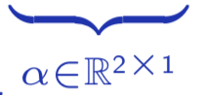

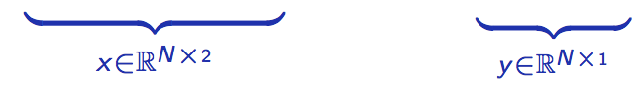
10 outputs
Linear
Activation
Linear
?
P(y=0)
P(y=1)
…
…
P(y=9)
Notes:
y \in R^{N\times10}

Slide 9
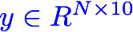
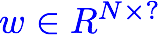

10 outputs
Linear
Activation
Linear
?
P(y=0)
P(y=1)
…
…
P(y=9)
?
Notes:
y \in R^{N\times10}

Slide 10
Probability
Linear
Activation
Linear
?
P(y=0)
P(y=1)
…
…
P(y=9)
Notes:
y \in R^{N\times10}

Slide 11
(log)Softmax
Linear
Activation
Linear
logSoftmax
P(y=0)
P(y=1)
…
…
P(y=9)
Notes:
y \in R^{N\times10}

Slide 12
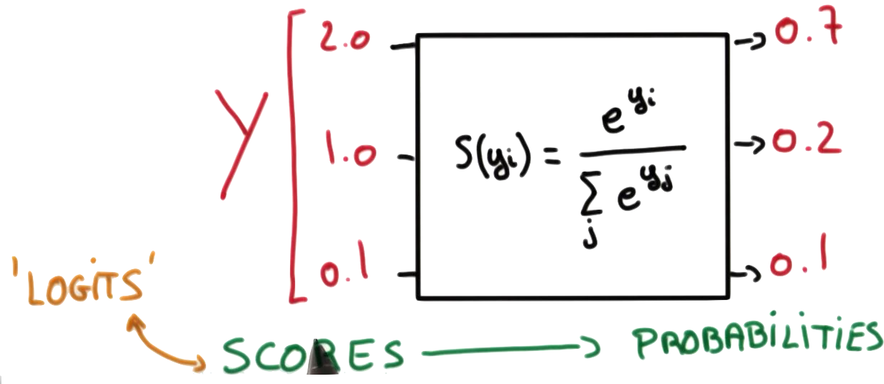
Softmax
Linear
Activation
Linear
logSoftmax
P(y=0)
P(y=1)
…
…
P(y=9)
https://www.udacity.com/course/deep-learning--ud730
Notes:
y \in R^{N\times10}

Slide 13
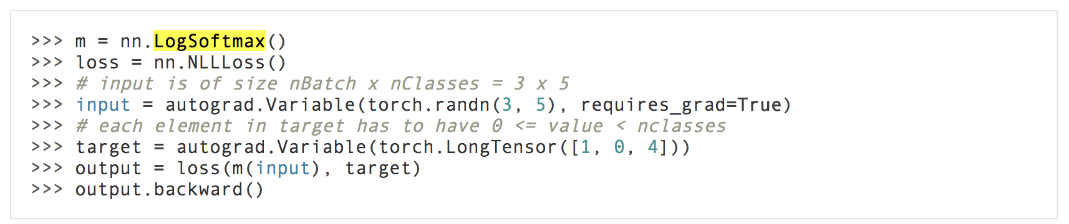
LogSoftmax with NLLLoss
http://pytorch.org/docs/master/nn.html#nllloss

Slide 14
(log)Softmax + NLLLoss
Linear
Activation
Linear
logSoftmax
P(y=0)
P(y=1)
…
…
P(y=n)
NLLLoss
With NLLLoss

Slide 15

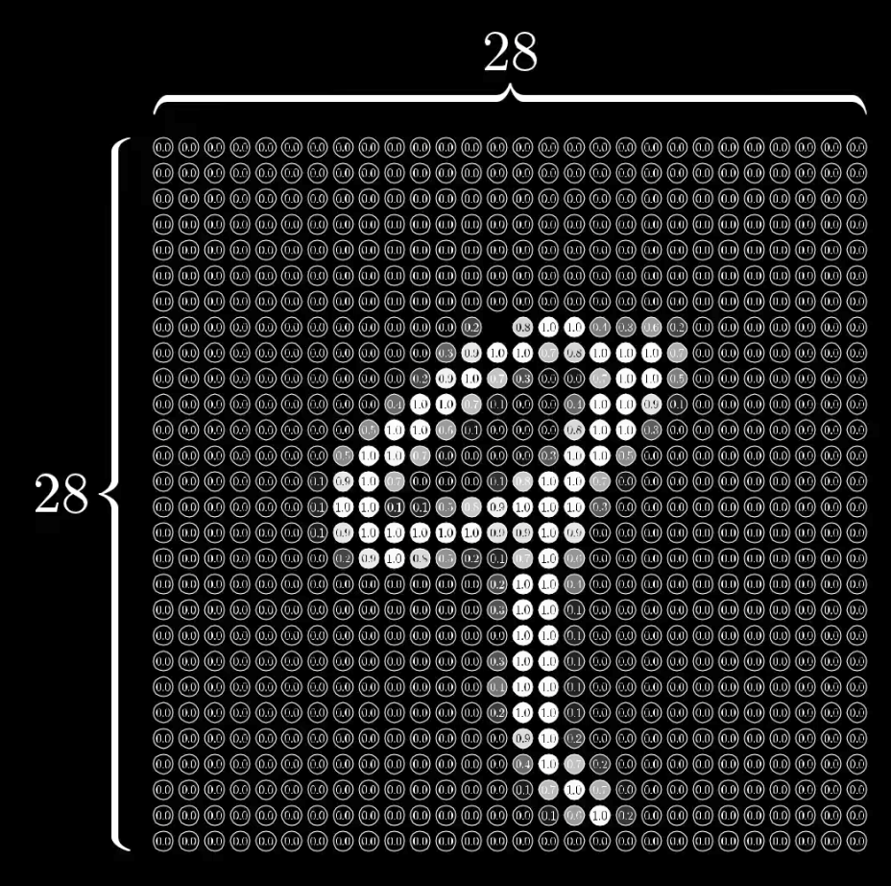
MNIST input
28x28 pixels = 748
https://www.youtube.com/watch?v=aircAruvnKk&t=1s

Slide 16
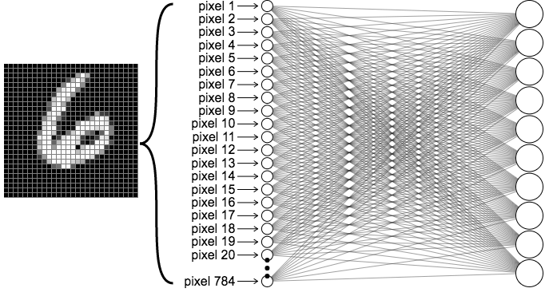



MNIST Network
output layer
10 (labels)
Input layer 784
https://ml4a.github.io/ml4a/looking_inside_neural_nets

Slide 17
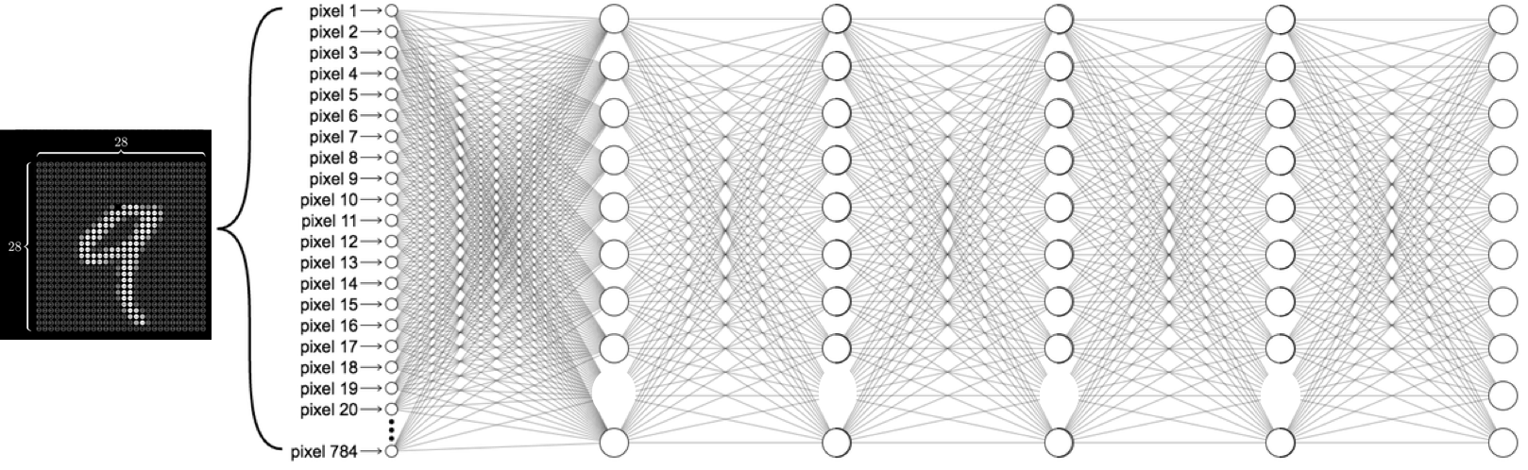
MNIST Network
Input layer 784
Hidden layers
output layer
10 (labels)
https://ml4a.github.io/ml4a/looking_inside_neural_nets

Slide 18
MNIST Network
Input layer 784
hidden 1: 520
hidden 2: 320
hidden 3: 240
hidden 3: 120
output layer
10 (labels)
https://ml4a.github.io/ml4a/looking_inside_neural_nets

Slide 19

MNIST Network
self.l1 = nn.Linear(784, 520)
self.l2 = nn.Linear(520, 320)
self.l3 = nn.Linear(320, 240)
self.l4 = nn.Linear(240, 120)
self.l5 = nn.Linear(120, 10)
https://ml4a.github.io/ml4a/looking_inside_neural_nets

Slide 20
Softmax & NLL loss
class Net(nn.Module):
def __init__(self):
super(Net, self).__init__()
self.l1 = nn.Linear(784, 520)
self.l2 = nn.Linear(520, 320)
self.l3 = nn.Linear(320, 240)
self.l4 = nn.Linear(240, 120)
self.l5 = nn.Linear(120, 10)
def forward(self, x):
# Flatten the data (n, 1, 28, 28)-> (n, 784)
x = x.view(-1, 784)
x = F.relu(self.l1(x))
x = F.relu(self.l2(x))
x = F.relu(self.l3(x))
x = F.relu(self.l4(x))
x = F.relu(self.l5(x))
return F.log_softmax(x)
Input layer 784
hidden 1: 520
hidden 2: 320
hidden 3: 240
hidden 3: 120
output layer
10 (labels)
Notes:
\hat{y}=x*w+b
loss = \frac{1}{N}\sum_{n=1}^{N} y^{(n)} \log \hat{y}^{(n)} + (1 - y^{(n)}) \log (1-\hat{y}^{(n})

Slide 21
Softmax & NLL loss
class Net(nn.Module):
def __init__(self):
super(Net, self).__init__()
self.l1 = nn.Linear(784, 520)
self.l2 = nn.Linear(520, 320)
self.l3 = nn.Linear(320, 240)
self.l4 = nn.Linear(240, 120)
self.l5 = nn.Linear(120, 10)
def forward(self, x):
# Flatten the data (n, 1, 28, 28)-> (n, 784)
x = x.view(-1, 784)
x = F.relu(self.l1(x))
x = F.relu(self.l2(x))
x = F.relu(self.l3(x))
x = F.relu(self.l4(x))
x = F.relu(self.l5(x))
return F.log_softmax(x)
for batch_idx, (data, target) in enumerate(train_loader):
data, target = Variable(data), Variable(target)
optimizer.zero_grad()
output = model(data)
loss = F.nll_loss(output, target)
loss.backward()
optimizer.step()
Notes:
\hat{y}=x*w+b
loss = \frac{1}{N}\sum_{n=1}^{N} y^{(n)} \log \hat{y}^{(n)} + (1 - y^{(n)}) \log (1-\hat{y}^{(n})

Slide 22
MNIST Softmax
# Training settings
batch_size = 64
train_loader = torch.utils.data.DataLoader(
datasets.MNIST('../data', train=True, download=True, transform=transforms.Compose([
transforms.ToTensor(),
transforms.Normalize((0.1307,), (0.3081,))])),
batch_size=batch_size, shuffle=True)
test_loader = torch.utils.data.DataLoader(
datasets.MNIST('../data', train=False, transform=transforms.Compose([
transforms.ToTensor(),
transforms.Normalize((0.1307,), (0.3081,))])),
batch_size=batch_size, shuffle=True)
class Net(nn.Module):
def __init__(self):
super(Net, self).__init__()
self.l1 = nn.Linear(784, 520)
self.l2 = nn.Linear(520, 320)
self.l3 = nn.Linear(320, 240)
self.l4 = nn.Linear(240, 120)
self.l5 = nn.Linear(120, 10)
def forward(self, x):
x = x.view(-1, 784) # Flatten the data (n, 1, 28, 28)-> (n, 784)
x = F.relu(self.l1(x))
x = F.relu(self.l2(x))
x = F.relu(self.l3(x))
x = F.relu(self.l4(x))
x = F.relu(self.l5(x))
return F.log_softmax(x)
model = Net()
optimizer = optim.SGD(model.parameters(), lr=0.01, momentum=0.5)
def train(epoch):
model.train()
for batch_idx, (data, target) in enumerate(train_loader):
data, target = Variable(data), Variable(target)
optimizer.zero_grad()
output = model(data)
loss = F.nll_loss(output, target)
loss.backward()
optimizer.step()
if batch_idx % 10 == 0:
print('Train Epoch: {} [{}/{} ({:.0f}%)]\tLoss: {:.6f}'.format(
epoch, batch_idx * len(data), len(train_loader.dataset),
100. * batch_idx / len(train_loader), loss.data[0]))

Slide 23

Accuracy?
# Training settings
batch_size = 64
train_loader = torch.utils.data.DataLoader(
datasets.MNIST('../data', train=True, download=True, transform=transforms.Compose([
transforms.ToTensor(),
transforms.Normalize((0.1307,), (0.3081,))])),
batch_size=batch_size, shuffle=True)
test_loader = torch.utils.data.DataLoader(
datasets.MNIST('../data', train=False, transform=transforms.Compose([
transforms.ToTensor(),
transforms.Normalize((0.1307,), (0.3081,))])),
batch_size=batch_size, shuffle=True)
class Net(nn.Module):
def __init__(self):
super(Net, self).__init__()
self.l1 = nn.Linear(784, 520)
self.l2 = nn.Linear(520, 320)
self.l3 = nn.Linear(320, 240)
self.l4 = nn.Linear(240, 120)
self.l5 = nn.Linear(120, 10)
def forward(self, x):
x = x.view(-1, 784) # Flatten the data (n, 1, 28, 28)-> (n, 784)
x = F.relu(self.l1(x))
x = F.relu(self.l2(x))
x = F.relu(self.l3(x))
x = F.relu(self.l4(x))
x = F.relu(self.l5(x))
return F.log_softmax(x)
model = Net()
optimizer = optim.SGD(model.parameters(), lr=0.01, momentum=0.5)
def train(epoch):
model.train()
for batch_idx, (data, target) in enumerate(train_loader):
data, target = Variable(data), Variable(target)
optimizer.zero_grad()
output = model(data)
loss = F.nll_loss(output, target)
loss.backward()
optimizer.step()
if batch_idx % 10 == 0:
print('Train Epoch: {} [{}/{} ({:.0f}%)]\tLoss: {:.6f}'.format(
epoch, batch_idx * len(data), len(train_loader.dataset),
100. * batch_idx / len(train_loader), loss.data[0]))

Slide 24

train_loader = torch.utils.data.DataLoader(
datasets.MNIST('../data', train=True, download=True, transform=transforms.Compose([
transforms.ToTensor(),
transforms.Normalize((0.1307,), (0.3081,))
])),
batch_size=batch_size, shuffle=True)
test_loader = torch.utils.data.DataLoader(
datasets.MNIST('../data', train=False, transform=transforms.Compose([
transforms.ToTensor(),
transforms.Normalize((0.1307,), (0.3081,))
])),
batch_size=batch_size, shuffle=True)
def train(epoch):
...
def test():
model.eval()
test_loss = 0
correct = 0
for data, target in test_loader:
data, target = Variable(data, volatile=True), Variable(target)
output = model(data)
# sum up batch loss
test_loss += F.nll_loss(output, target, size_average=False).data[0]
# get the index of the max log-probability
pred = output.data.max(1, keepdim=True)[1]
correct += pred.eq(target.data.view_as(pred)).cpu().sum()
test_loss /= len(test_loader.dataset)
print('\nTest set: Average loss: {:.4f}, Accuracy: {}/{} ({:.0f}%)\n'.format(
test_loss, correct, len(test_loader.dataset),
100. * correct / len(test_loader.dataset)))

Slide 25
Accuracy?
def train(epoch):
model.train()
for batch_idx, (data, target) in enumerate(train_loader):
data, target = Variable(data), Variable(target)
optimizer.zero_grad()
output = model(data)
loss = F.nll_loss(output, target)
loss.backward()
optimizer.step()
if batch_idx % 10 == 0:
print('Train Epoch: {} [{}/{} ({:.0f}%)]\tLoss: {:.6f}'.format(
epoch, batch_idx * len(data), len(train_loader.dataset),
100. * batch_idx / len(train_loader), loss.data[0]))
def test():
model.eval()
test_loss = 0
correct = 0
for data, target in test_loader:
data, target = Variable(data, volatile=True), Variable(target)
output = model(data)
# sum up batch loss
test_loss += F.nll_loss(output, target, size_average=False).data[0]
# get the index of the max log-probability
pred = output.data.max(1, keepdim=True)[1]
correct += pred.eq(target.data.view_as(pred)).cpu().sum()
test_loss /= len(test_loader.dataset)
print('\nTest set: Average loss: {:.4f}, Accuracy: {}/{} ({:.0f}%)\n’.
format(test_loss, correct, len(test_loader.dataset),
100. * correct / len(test_loader.dataset)))
for epoch in range(1, 10):
train(epoch)
test()
Train Epoch: 9 [46720/60000 (78%)] Loss: 0.790513
Train Epoch: 9 [47360/60000 (79%)] Loss: 0.335216
Train Epoch: 9 [48000/60000 (80%)] Loss: 0.675538
Train Epoch: 9 [48640/60000 (81%)] Loss: 0.359488
Train Epoch: 9 [49280/60000 (82%)] Loss: 0.276906
Train Epoch: 9 [49920/60000 (83%)] Loss: 0.412109
Train Epoch: 9 [50560/60000 (84%)] Loss: 0.556780
Train Epoch: 9 [51200/60000 (85%)] Loss: 0.332712
Train Epoch: 9 [51840/60000 (86%)] Loss: 0.514475
Train Epoch: 9 [52480/60000 (87%)] Loss: 0.515686
Train Epoch: 9 [53120/60000 (88%)] Loss: 0.462904
Train Epoch: 9 [53760/60000 (90%)] Loss: 0.571690
Train Epoch: 9 [54400/60000 (91%)] Loss: 0.446774
Train Epoch: 9 [55040/60000 (92%)] Loss: 0.441682
Train Epoch: 9 [55680/60000 (93%)] Loss: 0.438245
Train Epoch: 9 [56320/60000 (94%)] Loss: 0.470004
Train Epoch: 9 [56960/60000 (95%)] Loss: 0.474394
Train Epoch: 9 [57600/60000 (96%)] Loss: 0.527718
Train Epoch: 9 [58240/60000 (97%)] Loss: 0.614899
Train Epoch: 9 [58880/60000 (98%)] Loss: 0.512663
Train Epoch: 9 [59520/60000 (99%)] Loss: 0.474054
Test set: Average loss: 0.5403, Accuracy: 7820/10000 (78%)

Slide 26
Multiple label prediction?
No problem! Use logSoftmax + NLLLoss
Linear
Activation
Linear
logSoftmax
P(y=0)
P(y=1)
…
…
P(y=n)
NLLLoss
With NLLLoss

Slide 27


Lecture 10:
CNN

